Slide 1
JavaScript in depth variable declaration & datatypes

Slide 2
Initialization vs. Declaration vs. Assignment
A. Declaration
The act of creating a variable. This involves specifying a variable's name and a way of declaration.
B. Initialization
process of assigning an initial value to a variable at the time of its declaration.
C. Assignment
Giving a value to a variable that has already been declared.

Slide 3
JavaScript Data Types
Primitive
Complex
Object
Array
String
Number
Symbol
Boolean
Null
Undefined

Slide 4
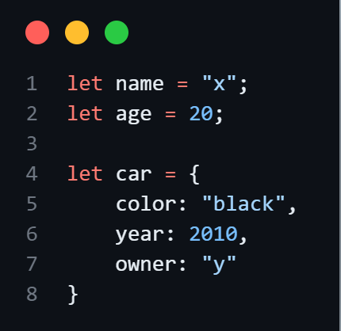
JavaScript is a high-level language “Dynamically Typed” “Garbage Collection”
Primitive types:
stored directly in the “stack”, where it accessed from
Complex types:
stored in “heap” and accessed by reference.
Stack
Heap
{
color:”black”
year:2010
owner:“y”
}
car
age=20
name=“x”

Slide 5

Declaration = Variable keyword + Variable name
ways to declare the variable
1- automatically
2- var keyword
3- let keyword
4- const keyword
camelCase naming format
Starts with a letter
Allowed special chars _ $

Slide 6
Comparing Variable Declarations
Feature | var | let | const
Scope | Function/global | Block | Block
Hoisting | Yes (undefined) | Yes (Temporal Dead Zone) | Yes (Temporal Dead Zone)
Redeclaration | Allowed | Not Allowed | Not Allowed
Initialization | Optional | Optional | Required
Reassignment | Allowed | Allowed | Not Allowed

Slide 7
Main Concepts:
JavaScript Hoisting is the behavior where the interpreter moves function and variable declarations to the top of their respective scope before executing the code
In the TDZ, a variable exists but it cannot be accessed. This prevents the variable from being used or accessed before a value is assigned to it.

Slide 8
Thanks

